Slide 1

Whom shall I send?
Isaiah 6:1-8

Slide 2
Matthew 11:28, "Come to me, all you who are weary and burdened, and I will give you rest."
Matthew 28:19, "Therefore go and make disciples of all nations, baptizing them in the name of the Father and of the Son and of the Holy Spirit."
Indian Primary School, "Come to learn, Go to serve".

Slide 3
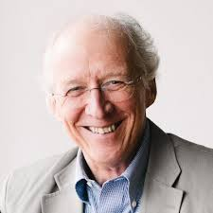
1. Come, Worship Me
Isaiah 6:1, "In the year that King Uzziah died, I saw the Lord seated on a throne, high and exalted, and the train of his robe filled the temple.“
Isaiah 6:2-4, "Above him were seraphs, each with six wings: With two wings they covered their faces, with two they covered their feet, and with two they were flying. 3. And they were calling to one another: "Holy, holy, holy is the Lord Almighty; the whole earth is full of his glory."
We do not worship in order to do missions, but we do missions in order to worship.
John Piper, ‘Mission exits because worship doesn’t. Worship is ultimate, not missions’

Slide 4
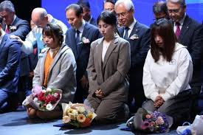
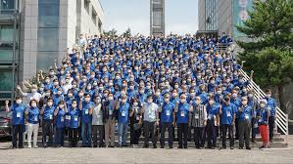
2. Go, Save the World
Isaiah 6:8, “Then I heard the voice of the Lord, saying, ‘Whom shall I send, and who will go for us?’”
The church is not the sender of missions. God sends us through the church.
Korea sent 28,039 missionaries to 171 countries for 140 years (2020)

Slide 5
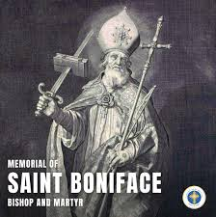
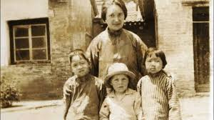
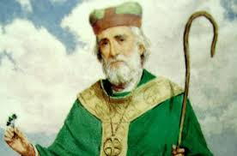
The biggest problem is that we don’t believe that God sends us.
Glady Aylward, “Eagles that fly in the sky don’t worry about crossing rivers.”
Boniface
St. Patrick

Slide 6
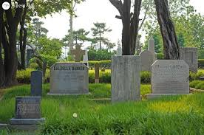
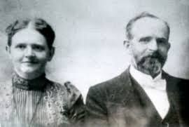
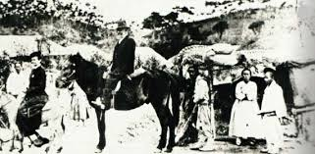
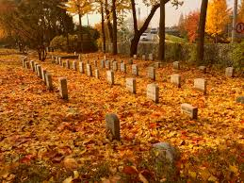
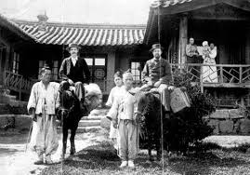
Yanghwajin
Tate and Mattie
Riding on the
horse

Slide 7
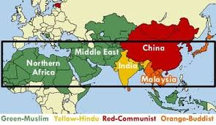
Unreached People
The Unreached People Group is a people group among which there is no indigenous community of believing Christians with adequate numbers (2%) and resources to evangelize this people group without outside assistance. (Joshua Project)

Slide 8
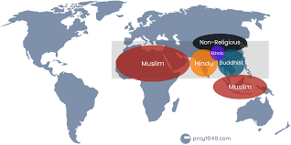
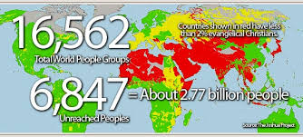

Slide 9
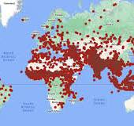
Population 1,490,666,000 | Number of Countries 58
Number of People Groups 3,749 | People Groups Unreached 972 (25.9%)
Population in Unreached 426,090,000 | Population in Unreached 28.6%

Slide 10
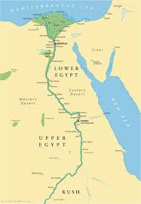
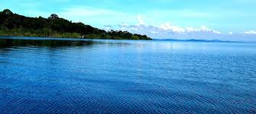
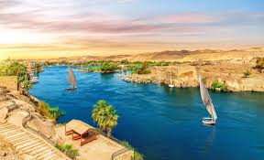
3. Victoria Vision
Ezekiel 47:9-12, 'As this water flows in, the sea water will be revived, and everything will live in all the places where this river reaches... and trees of every kind of fruit will grow on both sides of the river... and they will never fail to produce fruit...'

Slide 11
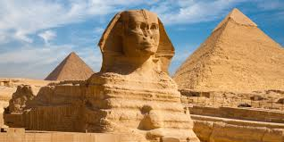
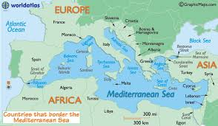
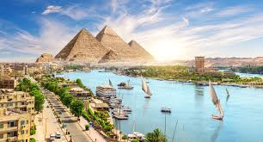

Slide 12
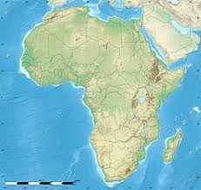

Uganda, Center of Africa Mission
God chose Uganda as the center of mission training in Africa!
And God also chose you !!
From here to where ?

